Slide 1
Concentration and agglomeration of IT innovation and entrepreneurship: Evidence from patenting
Chris Forman, Cornell University
Avi Goldfarb, University of Toronto
January 2020

Slide 2



Became rich from information technology
Will depend on information technology
Information technology
Notes:
This conference is motivated by this quote from Peter Thiel. Both inventions are IT. And Thiel himself made his fortune from IT. In some sense, the motivation for this entire conference is about IT.

Slide 3

Information technology matters to prosperity

Slide 4
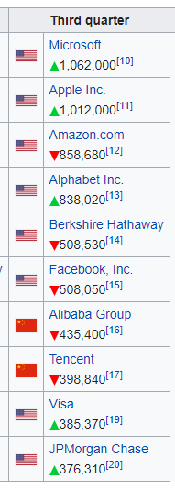
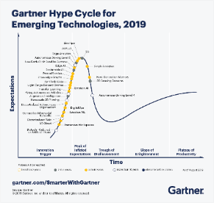
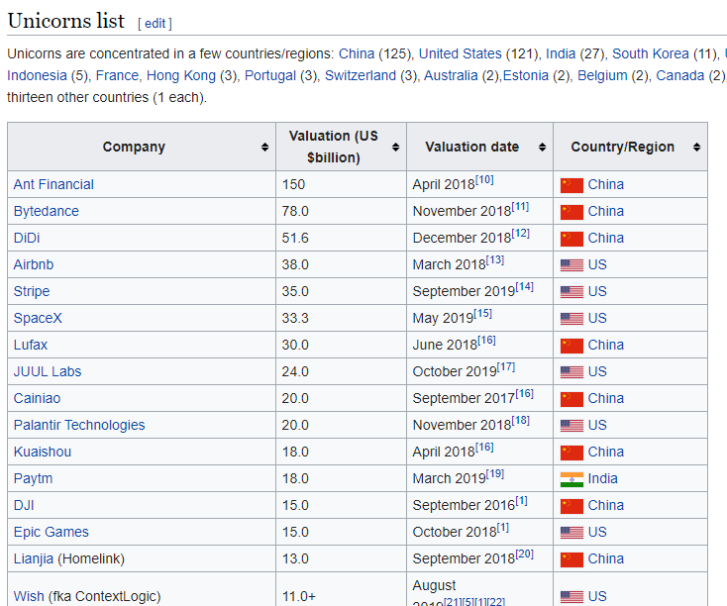
Many of the most prominent companies and emerging industries are information technology.

Slide 5
Top ten patenters by half decade
In bold, if also top ten in Computers & Communications
Top patenters are increasingly IT companies
1976-80 | 1981-85 | 1986-90 | 1991-95 | 1996-00 | 2001-05 | 2006-10
GE | GE | GE | IBM | IBM | IBM | IBM
AT&T | IBM | GM | Motorola | Micron | HP | Microsoft
IBM | AT&T | Kodak | GE | Lucent | Microsoft | Qualcomm
Westinghouse | Westinghouse | IBM | Kodak | Intel | Intel | GE
RCA | Dow Chemical | Dow Chemical | GM | HP | Micron | AT&T
USA/Sec. Navy | DuPont | DuPont | AT&T | Motorola | GE | Intel
DuPont | GM | AT&T | Xerox | GE | Texas I | HP
GM | Mobil | Motorola | Texas I | Kodak | Cisco | Honeywell
Dow Chemical | RCA | Westinghouse | 3M | AMD | Honeywell | Apple
Phillips Petro. | Allied Chemical | Allied Signal | DuPont | Xerox | Broadcom | Micron

Slide 6

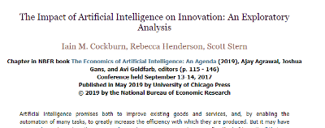
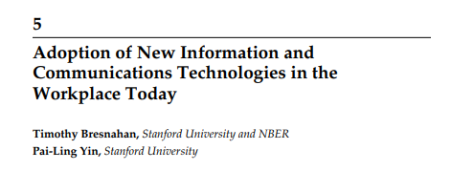
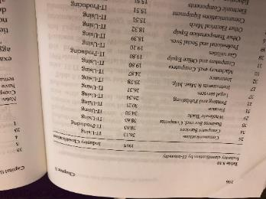
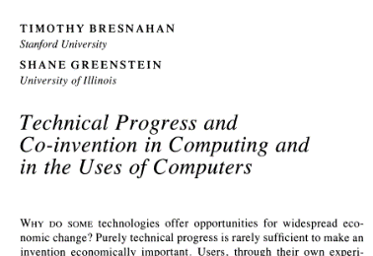
IT is an input into other inventions
Notes:
Jorgenson/Stiroh: IT using and IT producing
Bresnahan-Greenstein: Coinvention and computer usage
Cockburn Henderson Stern: Invention of method of invention
Bresnahan-Yin: ICT adoption and coinvention

Slide 7
There is a sense that the IT industry is relatively dynamic and competitive.
But that might be changing

Slide 8
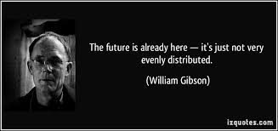
Notes:
The other motivating quote was from William Gibson. On the innovation side, we are now less well-distributed. In terms of location and in terms of firms. The future is here in SF but not really elsewhere. It is here in the large IT firms, but not really in the small ones. And this is increasingly true over time. That is our core result. Invention is more concentrated, particularly in ICT. New inventing firms are also more concentrated geographically (and more rare overall)

Slide 9





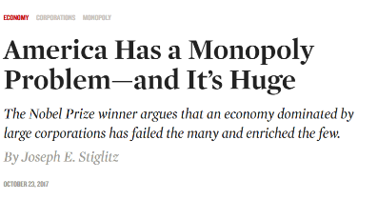
Rising concentration across firms

Slide 10
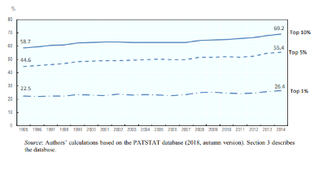
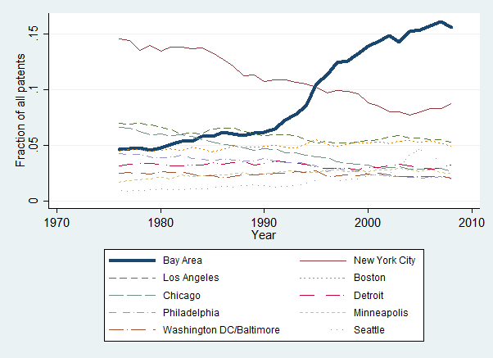
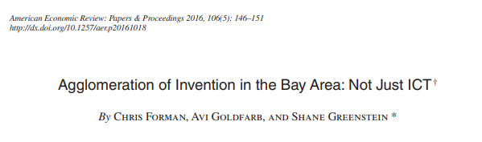
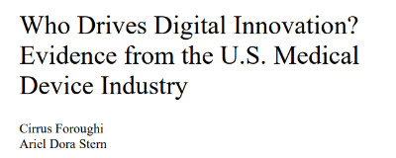
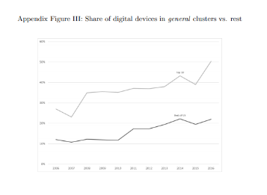
Rising concentration by location
OECD
Notes:
Forman, Chris, Avi Goldfarb, and Shane Greenstein. 2016. "Agglomeration of Invention in the Bay Area: Not Just ICT." American Economic Review, 106 (5): 146-51.
https://www.oecd-ilibrary.org/docserver/f184732a-en.pdf?expires=1576524705&id=id&accname=guest&checksum=D96ECEAFABC92F7E8AE5F873E5DB202E
https://www.hbs.edu/faculty/Publication%20Files/19-120_a1d7a285-f669-462f-a7bd-6643b73b1a7b.pdf

Slide 11


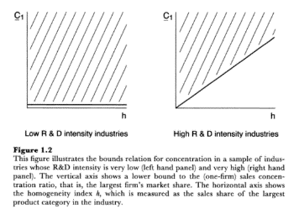
There are reasons to expect IT to lead to concentration
Shapiro and Varian (1998)
  “Information is costly to produce but cheap to reproduce” p. 21
  “Positive feedback makes the strong grow stronger” p. 174
Sutton (1998)
Notes:
Long literature documenting how IT should increased concentration (though admittedly also says decrease concentration—e.g. low search costs and switching costs highlighted in Shapiro and Varian).

Slide 12


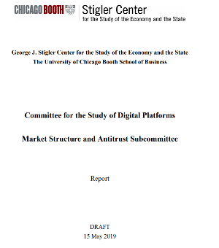
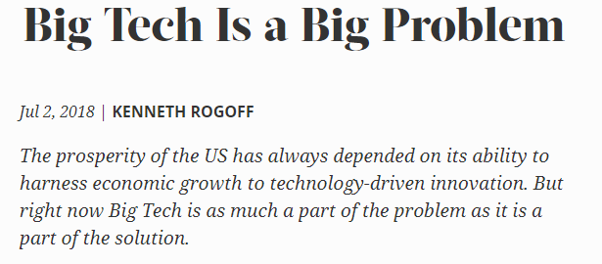
Therefore many blame IT for the increase
Notes:
IT is taking the blame for many of the problems in the economy.

Slide 13
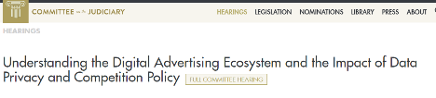

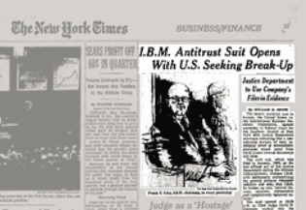
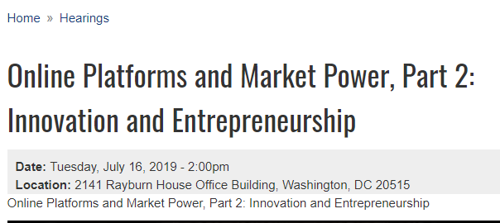

Regulatory context
Notes:
Leading to regulatory attention (though such attention goes back a long time!)

Slide 14
Definition of information technology
Merriam-Webster Dictionary: The technology involving the development, maintenance, and use of computer systems, software, and networks for the processing and distribution of data.
Wikipedia: The use of computers to store, retrieve, transmit, and manipulate data or information.
Economics and IS Handbook: the hardware and software used in the processing and communication of information.

Slide 15



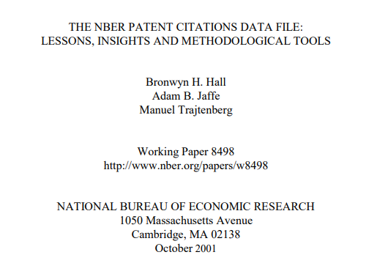
Our empirical definition in this paper
Identifying IT inventions in the patent data is difficult (see, e.g., Graham and Mowery 2003; Bessen and Hunt 2007; Hall and MacGarvie 2010). We think our results may be suggestive of a broader phenomenon that warrants further exploration.
Notes:
Gives a sense of the big picture, using a data set familiar to this audience. We see this as the first word rather than the last word on this evidence.

Slide 16
What we do
Look at trends in patenting concentration over time and across patent categories.
Calculate Gini coefficients by firm and by location, annually 1976-2010.
Document trends in the fraction and geographic concentration of patents by first time inventing firms and individual inventors.
Entirely descriptive.
Some trends are general, and others are specific to IT.
We will not identify why this is happening, whether the trends are robust to other definitions of innovation, or whether the trends in IT explain the overall changes in market concentration, location concentration, labor share, or productivity.

Slide 17
Data

Slide 18
The Data
US Patent and Trademarks Office Database.
  NBER “cleaned” data for some analysis
All US patents, application year 1976 to 2010
We have through 2017, so why end in 2010?
  NBER categories are poorly defined after 2010 due to changes in classification system
  The application year data starts to trail off after 2013 because of lags from application to patent grant.
Firm identities found from Kogan, Papanikolaou, Seru, and Stoffman (2017) and Stoffman, Woeppel, and Yavuz (2019).
Notes:
Leonid Kogan, Dimitris Papanikolaou, Amit Seru, Noah Stoffman, Technological Innovation, Resource Allocation, and Growth, The Quarterly Journal of Economics, Volume 132, Issue 2, May 2017, Pages 665–712, https://doi.org/10.1093/qje/qjw040.
Stoffman, Noah, Michael, Woeppel, M. Deniz Yavuz, 2019, “Small Innovators: No Risk, No Return,” Working paper, Available at Small Innovators: No Risk, No Return.
Thanks to Noah Stoffman for extensive help with the data.

Slide 19
Patents as a measure of innovation
We know that patents are an imperfect measure of innovation
    Hall and Ziedonis (2001), Graham and Mowery (2003); Hall and MacGarvie 2010, etc.
Some patents are more important than others, and many inventions may never be patented.
Patentability of software has varied over time, which will influence the propensity to patent
This will bias our results if the inventors in IT are increasingly likely to patent when they are in larger firms relative to smaller firms.
  It is OK if large firm inventors are more likely to patent. It is not OK if they are becoming increasingly likely to patent (relative to others) over time in IT relative to other industries.
Still, patents are a useful measure because they are observable, and comparable across time and categories.

Slide 20
Result 1: Concentration in IT patenting is increasing over time
Notes:
List six categories plus total. Highlight IT “Computers and communications” in thicker line. Note that there is some IT in other categories (e.g. semiconductor manufacturing in electrical and electronic).
IT patenting is much more concentrated now than it was.
Total gini is relatively high—probably because of a large number of firms with just one patent. Note that the gini calculation will not take firms with zero patents into account. It conditions on patenters.

Slide 21
Concentration increasing, while number of patents and number of patenters grow.
Notes:
Though number of patenters and patents generally rising. In IT, especially until about 2000.
Note that IT is now by far the largest patent category.

Slide 22
Result 2: Geographic concentration of IT patenting has grown
Recall FGG (2016 P&P)
Notes:
Location defined by county. So massive increase in concentration in a small number of counties since 1985.
Total gini is relatively high—probably because of a large number of locations with few patents. Note that the gini calculation will not take locations with zero patents into account. It conditions on at least one patent.
This is similar to the result in Forman, Chris, Avi Goldfarb, and Shane Greenstein. 2016. "Agglomeration of Invention in the Bay Area: Not Just ICT." American Economic Review, 106 (5): 146-51.

Slide 23
New patenters
Notes:
A focus on this conference is entrepreneurship. We don’t measure entrepreneurship directly, but we do measure firms that appear in the patent database for the first time. We use this to measure dynamism of invention by patent category.

Slide 24
Result 3: Sharp decline in new patenters, especially in IT 2000-2010
IT was different, with rise or steady from 1980-2000
2000-2004 maybe driven by software patents
Notes:
Mechanical decrease over time as the sample starts in 1976—so all are new patenters. Then mechanically more patenters accumulate. So the interesting result is the differences across categories. Note that IT was flat despite mechanical decrease from 1980 to 2000. Then it fell sharply.
There were several court cases in the late 90s that increased the patentability of software. Post our period, the big cases are Bilski (2010) and Alice (2014). The 2000-4 catch up is likely due to the rise of software patents. The reversal of trend so that it continues to decline after 2004 is more likely the speculated change in dynamics.
Put differently, the surprise here is that IT didn’t fall 1980-2000, rather than that IT did fall after.

Slide 25
Similar sharp decline in patenters that are individuals 2000-2010, especially in IT post 1980
Notes:
Results on new patenters also true in terms of individual patenters. Used to be much more common than it is today, across the board (though always relatively rare in IT).

Slide 26
Result 4: Increased geographic concentration of IT new patenters
Notes:
County level. First time companies are increasingly in the Bay Area.

Slide 27
Results not driven by a particular subclass of IT patenting
But effects are strongest in Electronic business methods and software
Notes:
Even true in semiconductor devices which are in category 4.
Strongest effects are in business methods in software, which relates to ability to protect patents in that areas.
Middle graph suggests business methods & software grow from effectively zero in mid 1990s to about 14% of total IT patents by 2007-2010 (not including semiconductors).

Slide 28
Bringing it together

Slide 29
Recall the opening
Many of the most prominent companies and emerging industries are
information technology.
IT is an input into other inventions.
There is rising concentration across firms both in IT and outside of IT.
There are reasons to expect IT to lead to concentration
Therefore maybe IT is to blame.

Slide 30
We document a change in concentration
Result 1: Firm concentration of IT patenting has grown over time
Result 2: Geographic concentration of IT patenting has grown
Result 3: Sharp decline in new patenters 2000-2010, especially in IT
Result 4: Increased geographic concentration of IT new patenters
  Preliminary results in the sense that we did not identify why this is happening, whether the trends are robust to other definitions of innovation, or whether the trends in IT explain the overall changes in market concentration, location concentration, labor share, or productivity.

Slide 31
Limitations/next steps
Our analyses uses patents, and the greatest increase in firm concentration occurs in software and business methods
  Propensity to patent in software has likely changed over time with the patentability of software
  Propensity to patent can differ by firm size, though unclear whether this has changed over time
We can probe this further by
  Looking at changes in concentration of highly cited patents (current analysis does not adjust for citations)
  Exploring whether we can use employment data from YTS to examine whether there are similar trends
Data end in patents applied in 2010
  Looking to see whether we can identify IT patents using CPC classes to generate preliminary findings to 2013

Slide 32
Information technology was relatively dynamic and competitive, and spatially diverse.
It is less so today.
(at least as measured by the patent data.)
Notes:
Concentration of IT innovation in a few firms and a few cities might lead to incremental innovation and innovation that is not widely shared.
Slide design brought to you by Microsoft’s Design Ideas AI!

Slide 33
Thank you

